Slide 1

人本集团介绍
Introduction to
C&U Group
www.cugroup.com
KOREA
按F5放映观看 (请把文件夹放到F盘根目录下)

Slide 2
  集团概况 Group overview
1
  生产基地 Manufacturing bases
2
  应用领域 Application
3
  研发技术 R&D capacity
4
  人本愿景 Vision of C&U
5
按F5放映观看 (请把文件夹放到F盘根目录下)

Slide 3
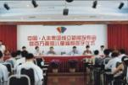



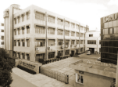
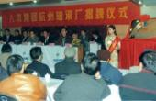
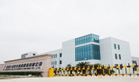
Ⅰ. 发展历程 History
人本集团成立
C&U Group
was founded
上海人本工业园开工
Shanghai C&U Industrial
Park began to build
人本集团产学研创造园开工建设
C&U Industry-University-Research Innovation Park began to build
1991
1997
1999
2004
2007
2012
创立温州市轴承厂
Wenzhou Bearing
Plant was established
参与国企改革
Participation in
State-owned companies’
reform and M&A
温州滨海工业园开工
Wenzhou Binhai
Industrial Park began
to build

Slide 4
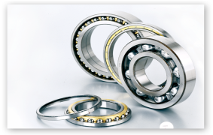
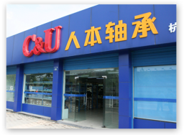
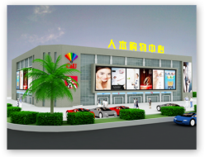
Ⅱ. 产业布局 Business segments
中国最大的轴承制造商(生产规模和销量)
Largest bearing manufacturer in China
(Production scale and sales volume)
最具市场竞争力品牌
Most competitive brand
轴承制造业 Bearing manufacturer
高整合度企业
Highly integrated company
机电贸易业
Electro-mechanical trade
商业超市
Commercial supermarkets
按F5放映观看 (请把文件夹放到F盘根目录下)

Slide 5




Ⅲ. 总体概览 General overview
员工
Employees
1.98万余人
More than 19800
资产总额
Assets
81.5亿元
RMB 8.15 billion
2013年底
Till end of 2013
销售收入
Turnover
120亿元
USD 2 billion
利税Profit & tax
5.5亿元
USD 90 million
税

Slide 6
单位：亿元/ Unit: RMB 100 million
年份/ Year
2006-2013年集团销售收入与轴承销售收入对比图
Comparison diagram between Group turnover and bearing turnover(2006-2013)
按F5放映观看 (请把文件夹放到F盘根目录下)

Slide 7

Ⅳ. 勇闯国际 Global presence
人本建立起一套完善的宽领域的服务网络，以更快的反馈满足客户的需求。
C&U has established a comprehensive, wide-ranging service network.
All these can guarantee quick response to meet our customers’ demands.
Europe
Limburg, Germany
Sales Office
Americas
Plymouth, MI
Sales Office
Technical Center
Warehouse
China Headquarters
Manufacturing
R&D Center
Sales Offices
Seiko
Osaka, Japan
Sales Office
Warehouse
按F5放映观看 (请把文件夹放到F盘根目录下)
*

Slide 8
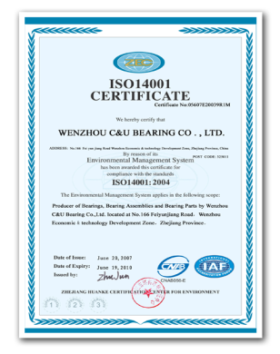
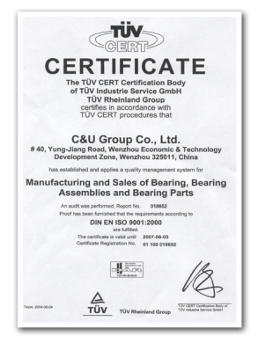
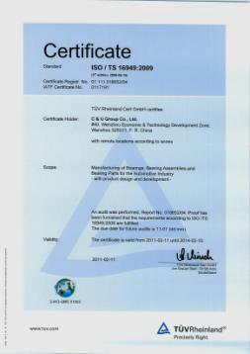
Ⅴ. 体系认证 System certificates
ISO/TS-16949
ISO14001
ISO9001
按F5放映观看 (请把文件夹放到F盘根目录下)

Slide 9
  集团概况 Group overview
1
  生产基地 Manufacturing bases
2
  应用领域 Application
3
  研发技术 R&D capacity
4
  人本愿景 Vision of C&U
5
按F5放映观看 (请把文件夹放到F盘根目录下)

Slide 10
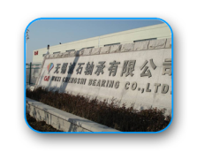
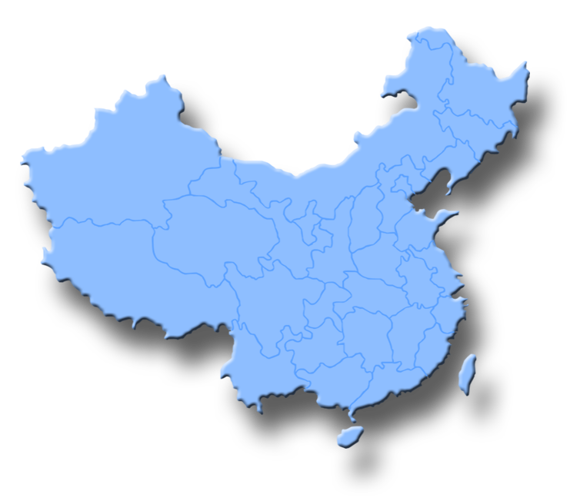
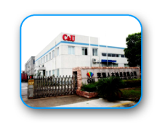
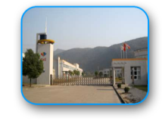
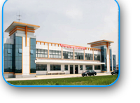
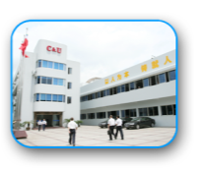
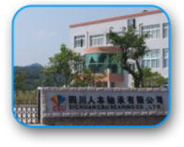
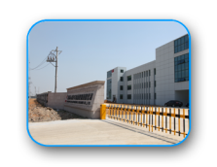
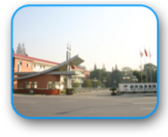
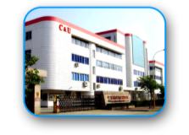
无锡基地
Wuxi Park
芜湖基地
Wuhu Park
黄石基地
Huangshi Park
上海基地 Shanghai Park
人本集团总部
C&U Group Headquarter
四川基地
Sichuan Park
杭州基地 Hangzhou Park
温州基地 Wenzhou Park

Slide 11
Ⅰ. 产品类别 Product category
生产基地 Production bases | 深沟球轴承 | 角接触球 轴承 | 调心球 / 滚子轴承 | 圆柱滚子 轴承 | 圆锥滚子 轴承
 | Deep Groove Ball Bearings | Angular Contact Ball Bearings | Self-Aligning Ball / Roller Bearings | Cylindrical Roller Bearing | Tapered Roller Bearings
Wenzhou | ü
Hangzhou | ü | ü | ü | ü | ü
Wuhu | ü |  |  | ü
Shanghai | ü | ü |  | ü | ü
Huangshi |  |  | ü
Sichuan | ü |  |  |  | ü
Wuxi | ü
按F5放映观看 (请把文件夹放到F盘根目录下)

Slide 12
Ⅰ. 产品类别 Product category
生产基地Locations | 推力球 轴承 | 滚针轴承 | 回转支承 | 水泵轴连 轴承 | 轮毂轴承 | 带座外球面球轴承
 | Thrust Ball Bearing | Needle Roller Bearing | Slewing Bearings | Water pump Bearing | Wheel Hub Bearings | Insert Bearing Units
Wenzhou | ü | ü
Hangzhou |  |  | ü |  |  | ü
Wuhu | ü |  |  |  |  | ü
Shanghai |  | ü |  | ü | ü
Huangshi
Sichuan
Wuxi
按F5放映观看 (请把文件夹放到F盘根目录下)

Slide 13
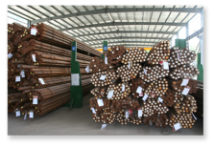
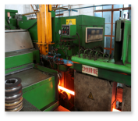
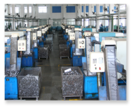
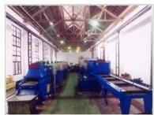

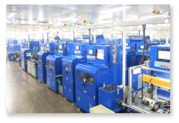
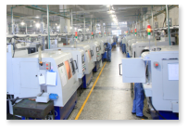

Ⅲ. 生产流程 Production process
人本制定自身的轴承钢材标准，对钢材、坯件加工、热处理、磨加工、装配等进行严格控制。
C&U formulates its own steel standards and makes strict control on steel, blank processing, heat treatment, grinding and assembly etc.
钢材
Steel
坯件加工
Blank processing
热处理
Heat treatment
交付
Delivery
检测
Inspection
装配
Assembly
磨加工
Grinding

Slide 14
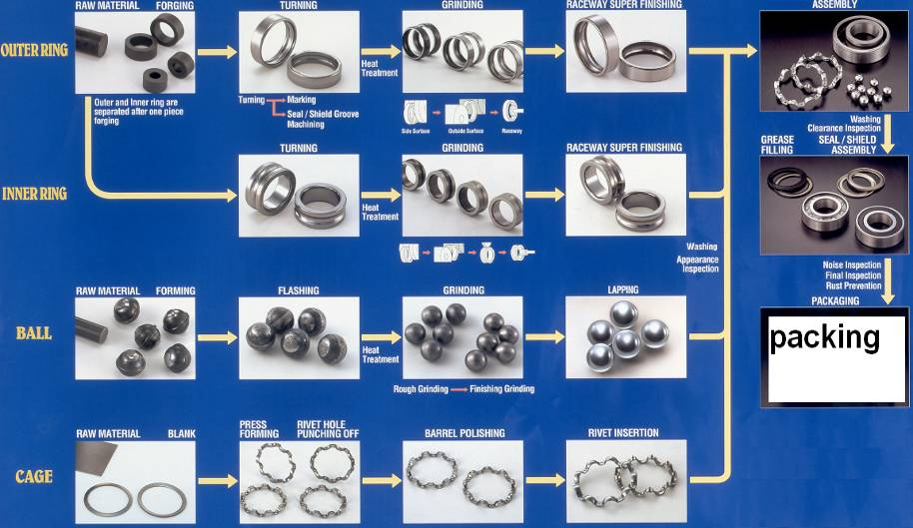
生产流程图 Production flow chart
以深沟球轴承为例 Take deep groove ball bearing as an example
按F5放映观看 (请把文件夹放到F盘根目录下)

Slide 15


















  主要过程流程布局图 Main Process Flow Chart
内圈IR
端面磨Groove Grinding1
沟磨 Groove Grinding1
内径磨Bore Grinding
内径检测 ID Inspection
沟道超精Super finishing
清洗Washing
甩干Centrifuge dripping
外圈OR
端面磨 Groove Grinding
无心磨 Groove Grinding
沟磨 Groove Grinding
沟道超精Super finishing
清洗
Washing
甩干Centrifuge dripping
外径检测 OD Inspection
组装Assembly
注脂Grease Injunction+压盖Press Seals
清洗+烘干+涂油Washing + Drying+ Oiling
内径+外径检测ID+OD Inspection
灵活性+径向游隙检测Flexibility +Radial clearance inspection
合套+铆合Assembly + Press Cage
按F5放映观看 (请把文件夹放到F盘根目录下)

Slide 16

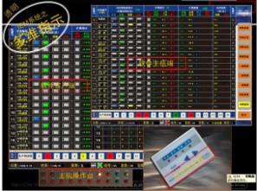
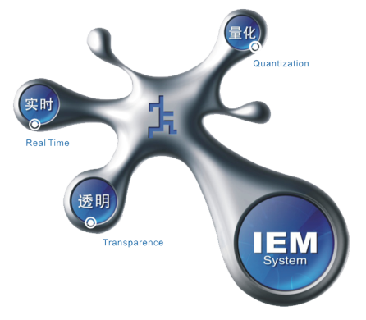
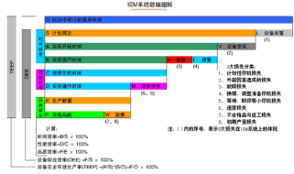
集团自身研发的 IEM生产控制系统，使生产过程中对设备、物料、人员实行有效管控，资源得到最大的整合效用。
C&U develops its IEM production control system by itself which can have a better control of equipments, materials and staffs so as to use resources more efficiently.

Slide 17





Quality and Process Control
Incoming Material Inspection
Heat Treatment
Automated lines
SPC, continuous monitoring
Grinding
Automatic NC grinding machine
SPC, 100% online ID and OD inspections
Forging
Assembly
Inspection
Packing & Shipping
Automatic assembly lines (100% radial clearance inspection, grease presence test)
100% noise inspection (Anderometer)
100% visual inspection
Automated lines
SPC, gauges, continuous monitoring
Suppliers audit, continuous improvements
Incoming inspections
Note: Example for deep groove ball bearing
Notes:
Most noise inspection takes place after grease and seal using acceleration (dB) measurement (not anderons).
Some lines are capable of measuring velocity (Anderons) as well.

Slide 18
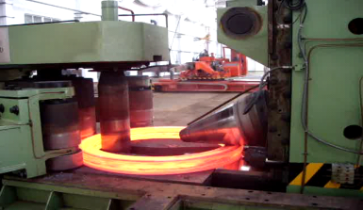
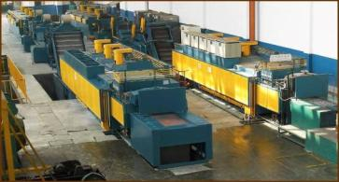
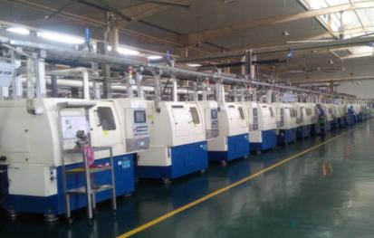
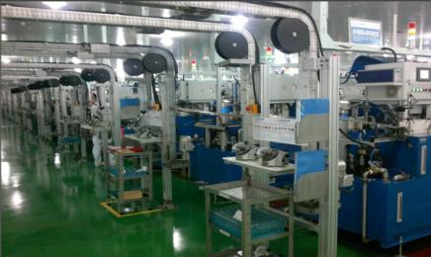
锻造 Forging 热处理 Heat treatment
磨加工生产线 Grinding lines 装配生产线 Assembly lines
按F5放映观看 (请把文件夹放到F盘根目录下)

Slide 19
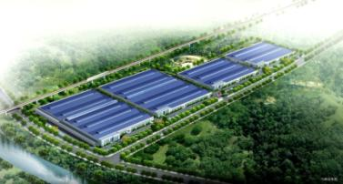
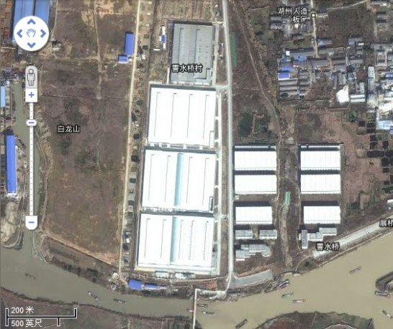
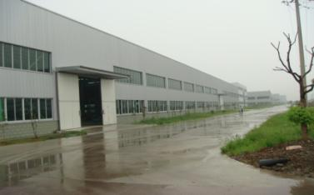
Huzhou(8+1) Raw material Plants
Forging，Turning，Heat treatment，Bearing steel pipe、Roller、Shield etc.

Slide 20

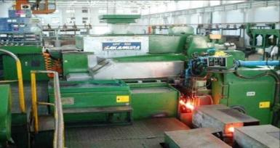
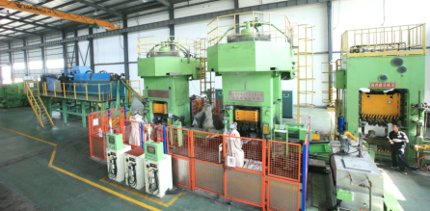
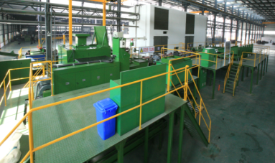
8+1Manufacturing Equipments (1)
Forging
Heat Treatment
Automatic Assembly Lines
Automatic Grinding Machines
C&U manufacturing equipment uses current technology and is in excellent condition.
Processes in place guarantee excellent consistency and quality
Forging, Heat Treatment, Grinding and Assembly in house.

Slide 21
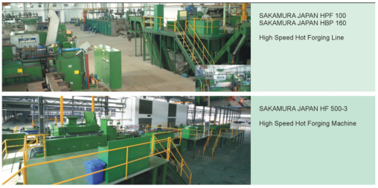
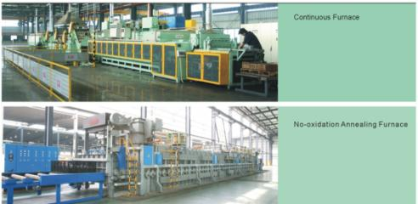
8+1Manufacturing Equipments (2)
8+1 also is supply high quality forging parts, with turning, heat treatment.
Total area: over 670,000sqm.
Main customer: Schaeffler, SKF, C&U, NSK, NTN

Slide 22
  集团概况 Group overview
1
  生产基地 Manufacturing bases
2
  应用领域 Application
3
  研发技术 R&D capacity
4
  人本愿景 Vision of C&U
5
按F5放映观看 (请把文件夹放到F盘根目录下)

Slide 23

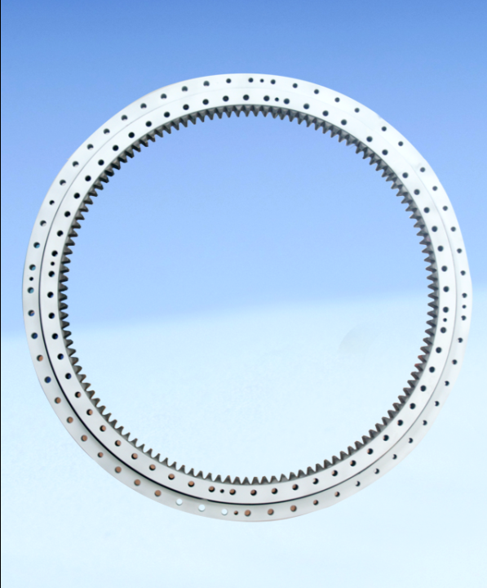
Ⅱ. 尺寸系列 Product size range
内径4000mm轴承
Inner diameter:
4000mm
内径1.5mm轴承
Inner diameter:
1.5mm
能生产内径1.5mm至4000mm各类轴承 3 万余种，2013年轴承产量7亿套左右。
C&U can produce more than 30000 kinds of bearings with inner diameter from 1.5mm to 4000mm. The production volume is about 700 million sets in 2013.

Slide 24
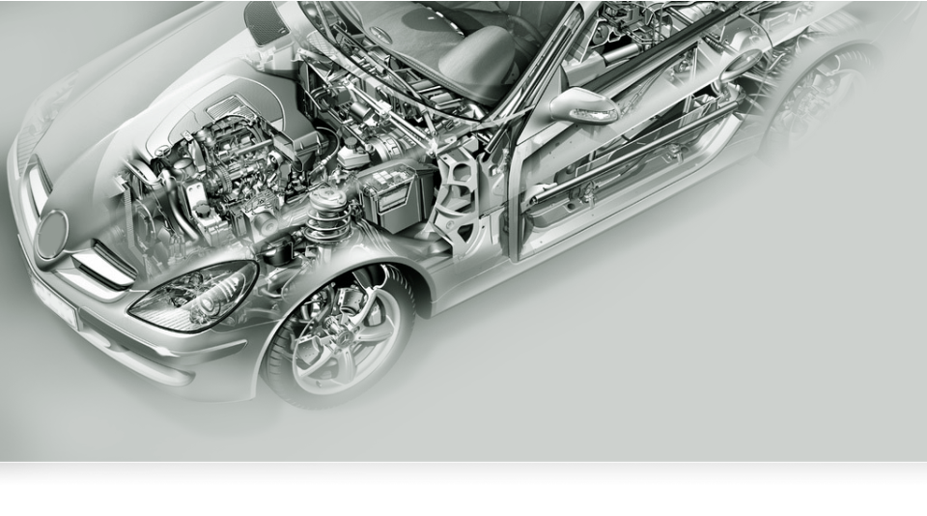
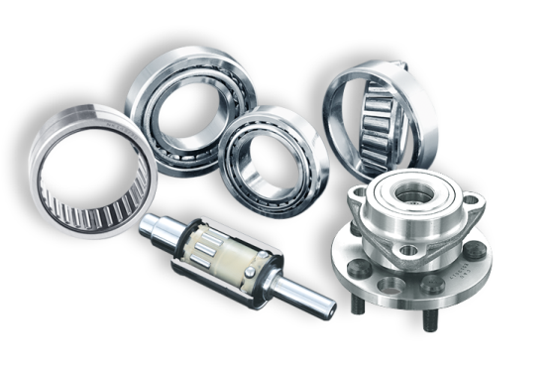
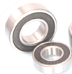
汽车轴承
Automobile bearings

Slide 25
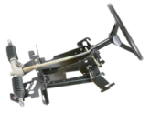

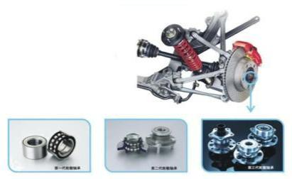
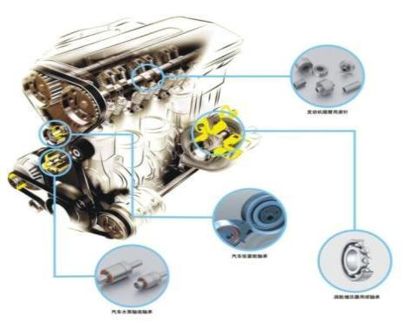
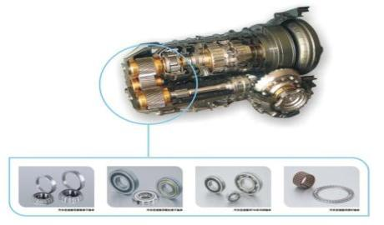


汽车轴承 Automotive Bearings
Bearings for cooling fan, viscous fan clutch
Steering Column Bearings
Rocker arm, crankshaft
Hub 1
Hub 2
Hub 3
Dampeners, Pulleys
Water pump Bearings
Turbocharger
Tapered, Cylindrical Rollers, Ball and Needle bearings for transmissions
Magnetic Clutch bearings
Alternator bearings

Slide 26


家用电器轴承
Household appliance bearings

Slide 27


摩托车轴承
Motorcycle bearings

Slide 28


电机、电动工具轴承
Electric motor & tools bearings

Slide 29



电梯轴承
Elevator bearings

Slide 30


精密轴承
Precise bearings

Slide 31


纺织机械轴承
Textile machinery bearings

Slide 32


工程机械轴承
Construction machinery bearings

Slide 33



冶金轧机轴承
Metallurgical bearings

Slide 34



风电轴承
Wind power bearings

Slide 35


办公自动化 微型轴承
Miniature bearings in OA field

Slide 36
应用领域 Application
涉及领域广
Wide range
有所重点
Focal points stand out
各领域占比图
Application field segments
按F5放映观看 (请把文件夹放到F盘根目录下)

Slide 37



















汽车类客户 Automotive customers
审核中
On auditing
已合作
On cooperation
按F5放映观看 (请把文件夹放到F盘根目录下)

Slide 38


















汽车类客户 Automotive customers
按F5放映观看 (请把文件夹放到F盘根目录下)

Slide 39
Axle Customers
GM Wulin | Xiangfan DANA
Chang’an | Shuguang
Shanxi Hande | Dongfeng
Hefei ArvinMeritor | NAVECO
Dongfeng DANA | Tianjin Guantong
ZhuHai Hainachuan | Haima
Chongqing Sokon | Haldex
FAW | Beijing YATAI
Changshu ArvinMeritor | Shuangguang
Anhui Ankai | Qianjin

Slide 40
Transmission Customers
ZF Brazil | Dongfeng
ZF America | Dongfeng commercial vehicle
FUJI Japan | Yancheng Zhongma
VE COMMERCIAL VEHICLES India | Zhejiang Wanliyang
TAFE India | Zhejiang Zhongtai
ZF Hangzhou | Zhejiang Zhongma
Honda (China) | FZD
Citroen China | Jiangkai Xiangfan
(SDS) GKN Shanghai | Anhui Longda
Getrag China | Anhui Haofang
Changhe SUZUKI | Hanhui Hubin
Tangshan AISIN | Ganzhou Jingwei
SAIC | Dong'an
SAIC Jinbei | FeiFan Gelin
TsingShan Chongqing | BYD
TsingShan Liuzhou | TIANJIN ZHONGDE

Slide 41
Customers of Automobile
Customer | Bearing Type | Application | Vehicle Model & Remarks
ZF | Tapered Roller Bearing | Gearbox & Axle | Gearbox made by ZF Drivetech(Hangzhou) & (Suzhou) Co.,Ltd., end customers are FOTON and CAMC for commercial vehicles
 | Deep Groove Ball Bearing
 | Short Cylindrical Ball Bearing
 | Deep Groove Ball Bearing (stage of samples) | Steering System | ZF Drivetech (Hangzhou) Co.,Ltd.
(DPCA) Dongfeng Peugeot Citroen Automobile Co., Ltd. | Deep Groove Ball Bearing | Gearbox | Citroen ZX, Elysees, Piccaso, Peugeot 307,CitreonTriumph
BYD | Needle Roller Bearing | Gearbox | F0
 | Deep Groove Ball Bearing | Gearbox | F3
 | Needle Roller Bearing | Engine Rocker | F0, F3
 | Wheel Hub Bearing | Wheel Hub | F0, F3
 | Water Pump Bearing | Water Pump | F0, F3
Lianyungang Beifang Transmission Co. Ltd. | Deep Groove Ball Bearing | Gearbox | Dongfeng Xiaokangk17,Dongfeng Xiaokang k07,Chery QQ6,QQ3,Cowin,A1
 | Needle Roller Bearing | Gearbox | Chery A3,BYD F3, BYD F0

Slide 42
Customers of Automobile
Customer | Bearing Type | Application | Vehicle Model & Remarks
Getrag (Jiangxi) Transmission Co.,Ltd. | Deep Groove Ball Bearing | Gearbox | Jiangling Isuzu Pickup
(SGMW) Liuzhou SAIC-GM-Wuling Automotive Co., Ltd. | Deep Groove Ball Bearing | Gearbox | Wuling Sunshine, Wuling Rongguang
 | Tapered Roller Bearing | Axle | Wuling Sunshine, Wuling Rongguang
 | Wheel Hub Bearing | Wheel Hub | Wuling Sunshine, Wuling Rongguang
(JAC) Anhui Xingrui Transmission Co.,Ltd. | Deep Groove Ball Bearing | Gearbox | Heyue
 | Tapered Roller Bearing | Gearbox | Heyue
 | Other Bearings | Gearbox | Heyue
Shanghai GKN Drive Shaft Co., Ltd. | Deep Groove Ball Bearing | Drive Shaft | DPCA T53,Peuguot 206,307, SGM318 Platform
Shenghuabo Group | Deep Groove Ball Bearing | Wiper Motor | GM, Chysler, Peugeot, VWPQ34&35 Platform
SG Automotive Group | Tapered Roller Bearing | Gearbox | FOTON Haise, CheryTiggo, Changfeng Liebao, HuataiAuto
Fuxin Dare Automobile Steering Pump Co., Ltd. | Deep Groove Ball Bearing | Steering System | Fiat, Xiali, Yuchai, etc.
Xuelong Group | Double Row Ball Bearing | Viscous Fan Clutch | Major bus, Medium Bus, Truck, Heavy duty truck from FAW, DFAC, Sinotruck, FOTON

Slide 43
Customers of Automobile
Customer | Bearing Type | Application | Vehicle Model & Remarks
Jiangxi Changhe- Suzuki Automotive Co., Ltd. | Tapered Roller Bearing | Gearbox | Sedan
Tianjin Lovel Engines Co., Ltd. | Deep Groove Ball Bearing | Engine | Foton
FAW-Koyo Steering Co., Ltd. | Deep Groove Ball Bearing | Hydraulic Power Steering | Citron ZX, Elysees, Hyundai, Chang'an, Corolla, Geely, Maple
Mudanjiang Foton Automotive Air-Conditioner Compressor Co., Ltd. | Double Row Ball Bearing | Air Conditioner Compressor | Jetta, Jinbei, Brilliance, Geely, Chery, BYD
Anhui Haofang Electromechanics Co., Ltd. | Double Row Ball Bearing | Air Conditioner Compressor | FAW, DFAC, Brilliance
Tangshan Tongli Gear Co., Ltd. | Deep Groove Ball Bearing | Gearbox | Jeep, Nissan, BAW
Liuzhou Tsingshan Transmission Co., Ltd. | Deep Groove Ball Bearing | Gearbox | GM
Dongfeng DANA | Four Points Contact Ball Bearing | Axle | Domestic

Slide 44
Customers of Automobile
Customer | Bearing Type | Application | Vehicle Model & Remarks
Chongqi Tsingshan Transmission Branch,China South Industial Motors Company | Deep Groove Ball Bearing | Gearbox | Chang'an Star 2, Wuling Sunshine, Yuexiang, Tongyue,Benben, Mazda 2
 | Tapered Roller Bearing | Gearbox | Yuexiang, Tongyue
 | Needle Roller Bearing | Gearbox | Bingyue
Chengdu Tsingshan Industrial Co., Ltd. | Deep Groove Ball Bearing | Gearbox | Wuling Sunshine
Chongqing Chang’an-Suzuki Automotive Co., Ltd. | Deep Groove Ball Bearing | Gearbox | ALTO, SWIFT, Lingyang
 | Tapered Roller Bearing | Gearbox | ALTO, SWIFT, Lingyang
Hebei An Guo Longda Automotive Transmission Co.,Ltd. | Deep Groove Ball Bearing | Gearbox | Jinbei HIACE
Chery | Deep Groove Ball Bearing (stage of samples) | Gearbox | Chery Eastar
(SAGW) Shanghai Automotive Gear Works Co., Ltd. | Deep Groove Ball Bearing | Gearbox | Jiangling, S16
Heilongjiang North Automobile Braking System Co.,Ltd. | Deep Groove Ball Bearing | Chassis | Alto

Slide 45
Customers of Automobile
Customer | Bearing Type | Application | Vehicle Model & Remarks
Great Wall Motors | Wheel Hub Bearing | Wheel Hub(1,3) | GW Peri, Hover
Geely | Wheel Hub Bearing | Wheel Hub(1,3) | Geely
South TRW Chassis System Co., Ltd. | Wheel Hub Bearing | Wheel Hub(1) | Lifan 520
Delphi | Deep Groove Ball Bearing | Fuel Pump | Renault Commercial Vehicle (Export)
BorgWarner | Deep Groove Ball Bearing | Transfer case | GW, FOTON
 | Water Pump Bearing | Water Pump | DPCA
Gates Winhere | Water Pump Bearing | Water Pump | After Market (Export)
Magna | Water Pump Bearing | Water Pump | FORD (Export - Stage of Samples)
BOSCH | Deep Groove Ball Bearing | Alternator & Steering Motors | Domestic, Germany
GM of North America | Tapered Roller Bearing | Gearbox | Export - Stage of Samples
GETRAG USA | Tapered Roller Bearing | Gearbox | Export - Stage of Samples
Valeo | Deep Groove Ball Bearing | Alternator | Wuling Sunshine, Great Wall
Remy | Deep Groove Ball Bearing | Alternator | Chery, Geely, BYD
Halla Electric. | Deep Groove Ball Bearing | Alternator | Daewoo, Chery
Yuanzhou | Deep Groove Ball Bearing | Alternator | Lada, Volga
Mitsubishi Electric | Deep Groove Ball Bearing | Alternator | Domestic & Export
Beijing Aobo | Deep Groove Ball Bearing | Alternator | Yuchai, Wuxi & Dalian Diesel Engine
Iskra | Deep Groove Ball Bearing | Alternator | Export
TARA | Deep Groove Ball Bearing | Alternator | Export
LLC Pramo | Deep Groove Ball Bearing | Alternator | Export

Slide 46




Slide 47
















电机/家电客户 Electric motor/ household appliance customer example list
Electric motor:
Household appliance:
按F5放映观看 (请把文件夹放到F盘根目录下)

Slide 48










摩托车客户 Motorcycle customers
印度TVS （India）
广州大运
Guangzhou Dayun
按F5放映观看 (请把文件夹放到F盘根目录下)

Slide 49














电梯客户 Elevator customers
按F5放映观看 (请把文件夹放到F盘根目录下)

Slide 50







工业客户列举 Industrial customer list
按F5放映观看 (请把文件夹放到F盘根目录下)

Slide 51










重工业客户 Heavy industrial customer list
按F5放映观看 (请把文件夹放到F盘根目录下)

Slide 52

人本“上帝墙”
C&U Customer Collection--- “ The Wall of Gods”
按F5放映观看 (请把文件夹放到F盘根目录下)

Slide 53
  集团概况 Group overview
1
  生产基地 Manufacturing bases
2
  应用领域 Application
3
  研发技术 R&D capacity
4
  人本愿景 Vision of C&U
5
按F5放映观看 (请把文件夹放到F盘根目录下)

Slide 54




研发技术 R&D capacity
已获专利150多项
Obtained more than 150 patents
参与制定国家及行业标准38项
Participation in 38 national and
industrial standards’ formulation
2013年自主开发新产品1000多个
More than 1,000 new
products were developed
in 2013
按F5放映观看 (请把文件夹放到F盘根目录下)

Slide 55

研发技术 R&D capacity
实验室认可证书
Laboratory Accreditation Certificate
按F5放映观看 (请把文件夹放到F盘根目录下)

Slide 56









Ⅰ. 设计能力 Design capacity
设计、计算、分析软件的运用
Design, calculation and analysis software
☆ 计算机辅助软件：
AUTOCAD
UniGraphics
PRO Engineer
SOLIDWORKS
CATIA
☆ 分析软件：
Ansys
ROMAX
按F5放映观看 (请把文件夹放到F盘根目录下)
*

Slide 57


Ⅱ. 试验能力 Testing capacity
试验机：150台
试验中心面积：2200m^{2;}
员工： 32
Testing machines: 150
Test Center area: 2200m^{2;}
Employees: 32
寿命试验 Life test
盐雾试验 Salt-spray test
泥水试验 Muddy water test
油脂性能试验 Grease performance test
密封件性能试验 Seal performance test
高低温试验 High/ Low temperature test
……
寿命试验控制系统
Life test control system
按F5放映观看 (请把文件夹放到F盘根目录下)
*

Slide 58







Ⅱ. 试验能力 Testing capacity
耐久性试验机 Durability test
试验控制室 Test monitoring room
油脂性能试验机 Grease performance test
泥水试验 Muddy water test
盐雾试验 Salt-spray test
高低温试验机
High/Low temperature test
按F5放映观看 (请把文件夹放到F盘根目录下)

Slide 59






Ⅲ. 分析能力 Analysis capacity
☆ 原材料/热处理检测分析 Material/Heat-Treatment check and analysis
☆ 尺寸测量分析 Dimension and shape measuring analysis
☆ 圆度/粗糙度/波纹度/振动测试分析 Roundness/Roughness/Waviness/Vibration measuring analysis
☆ 润滑脂/润滑油分析 Lubrication oil/grease analysis
元素分析仪 Oxygen, Nitrogen &
Hydrogen Content
金相显微镜
Metallurgical microscope
红外光谱仪
Infrared Spectrum
硬度测量仪
Hardness Tester
泰勒轮廓仪
Taylor Profile Meter
二维成像仪
2D Image Measuring Machine
按F5放映观看 (请把文件夹放到F盘根目录下)

Slide 60




Ⅲ. 分析能力 Analysis capacity
SEM+EDS (energy-dispersive spectrometry)
CMM
泰勒圆度仪
Taylor Roundness Meter
表面应力分析
Surface stress analysis
按F5放映观看 (请把文件夹放到F盘根目录下)

Slide 61
  集团概况 Group overview
1
  生产基地 Manufacturing bases
2
  应用领域 Application
3
  研发技术 R&D capacity
4
  人本愿景 Vision of C&U
5
按F5放映观看 (请把文件夹放到F盘根目录下)

Slide 62



人本愿景 C&U vision
NSK
JTEKT
TIMKEN
NTN
SKF
Schaeffler
NMB
NACHI
跨越 Leap forward
跻身世界轴承行业前八强
To become one of top 8 in the world
按F5放映观看 (请把文件夹放到F盘根目录下)

Slide 63


诚信是基石，
双赢是动力，
团结合作是一条最好的路。
Credibility is the foundation
Win-win is the motive
Cooperation and Unity
is the best way
谢谢您的观赏！
Thanks for your attention!
KOREA

